Slide 1
Project Management

Slide 2
Main Phases
Development
deployment
Operation
retirement
Maintenance
t

Slide 3
Development
Requirements
definition
Req. inspection
Requirement
document
Design
Des. inspection
Design
document
Implemen
tation
Code inspection + test
Code
Project management
Configuration management
t

Slide 4
Plans are worthless
But planning is everything
  Dwight Eisenhower

Slide 5
Project management
How much?
  Upfront: Estimation
  During and after: tracking
When ready?
  Upfront: Estimation, scheduling
  During and after: tracking
Who does what?
  Team organization, scheduling, work allocation

Slide 6
Outline
Activities
Concepts and techniques
Measures
Estimation
Scheduling
Tracking
Post Mortem

Slide 7
PM activities
planning (estimation, scheduling)
tracking replanning
post mortem
Development
Inception
deployment
official project start
release
Operation
Maintenance
time
Notes:
Not really in scale
PM starts before the process (official start with contract signed)
In planning: estimation and scheduling

Slide 8
PM - inception
Projects do not start ‘in zero time’
Inception phase
  Initial analysis of requirements
  Initial general architecture
  Initial estimate of duration and cost
  Commercial proposal

Slide 9
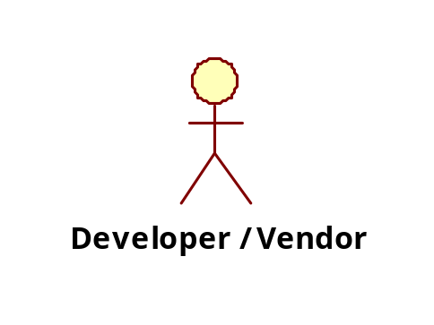
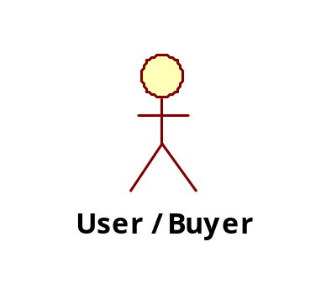
The vendor / buyer relationship
1 Commercial proposal
2 Legal Contract
3 Software product
or service

Slide 10
PM - inception
Not all projects pass the inception phase
Inception phase has a cost
  Normally not paid to vendor
  In very large projects may be paid, as ‘concept development’ or ‘feasibility study’

Slide 11
Common issues
Vendor tends to overpromise (or underestimate cost and time) to gain the contract
  Counting on variations (and related costs / gains) to be made later
  Counting on gains in maintenance / operation phase (buyer is typically locked in to vendor for maintenance)

Slide 12
Vendor buyer - variant
The software product / service could be developed internally
  Same organization develops and uses
  Typically can happen in large organizations that have an internal group/ office in charge of IT services

Slide 13
Vendor / buyer - variant
1 Commercial proposal
2 Legal Contract
3 Software product
or service
Internal IT office
Users in same
company

Slide 14
PM - development
  Proposal signed (as technical annex to legal contract)
  Development starts
  More detailed analysis of requirements, more detailed design
  Planning: more detailed estimation of duration and cost, scheduling activities and deliveries on calendar
  deciding organizational structure
  allocating resources

Slide 15
PM - development
  Development proceeds further
  Every week / month:
  Tracking: track usage of resources (time and money spent – cfr time sheet), compare with plan
  Replanning: in case of (large) deviations from plan, re-plan

Slide 16
PM – post mortem
Project ended
Learn for next projects
Post mortem phase
  Analyze good / bad choices, mistakes and successes, things to repeat, things to avoid

Slide 17
Concepts and techniques

Slide 18
Concepts and Techniques
Concepts
  Project, program
  Dimensions of projects
  Resource
  Phase, Activity
  Milestone
  Deliverable
Techniques
  Pert, Gantt, WBS, PBS

Slide 19
Project, program
Project: collaborative endeavour to achieve a goal, with defined limits of time / money
  Ex Manhattan project
Program: management of several related projects
  Ex Apollo program
    Apollo 1 project, Apollo 2 project, ...

Slide 20

Dimensions of software projects

Slide 21
Dimensions
As a product
(property/ copyright/ copyleft)
As a service
internal/ external
Bespoke / commercial

Slide 22
Dimensions of software projects
Number of buyers
  One: bespoke
    Ex, polito app
  Many: commercial, COTS (commercial off the shelf)
    Ex: MS Windows, LibreOffice, ..
  Effect on requirement engineering
      users better defined vs ill defined
      Wider vs narrower functionality

Slide 23
Dimensions
Product developed in the organization that uses it, or not
  Internal (larger organizations have internal IT department that may develop software projects)
  External
  Effect on vendor buyer relationship, effect on cost

Slide 24
Dimensions
As a service
      Product is not installed on user’s machines
Ownership
      Product is installed on user’s machines
  Property
    Full ownership (Normally applies to bespoke)
  Copyright
    Property remains to producer
    Copyright gives right to use
      No further copy, no reverse engineering, no modification
  Copyleft (opensource)
      Right to use, copy and modify
  Effect on requirements and design

Slide 25
Examples
Polito app
  Bespoke, internal, property
Polito HR management
  COTS, external, copyright
    Developed by CINECA

Slide 26
Typical scenarios
1 Bespoke, external, property, new
  Company C needs custom software product P
  Company SW develops it
    Inception, for requirement analysis and contract negotiation
    Contract signature (cost + delivery date + functionality agreed)
    Development, delivery

Slide 27
Typical scenarios
2 Bespoke, external, property, maintenance
  Company C needs maintenance work on owned software product P
  Company SW performs maintenance work
    Similar to case 1, but typically contract is per year and involves a fixed amount of work (or dedicated staff) in the year (ex 400 p-days) and not an amount of functionality (as in scenario 1)

Slide 28
Typical scenarios
1-a, 2-a
(same as above, but internal)
Bespoke, internal, property
    typical of bank, insurance,
    internal IT department instead of external vendor
    No legal contract, but similar negociation of functionality / effort requested between user department and IT department

Slide 29
Typical scenarios
3 COTS, external, copyright
  Company SW develops and sells a mass market product. Many users (companies, individuals) buy and use it as is
    Ex MS and Office, Windows. Oracle, SAP and ERP products.

Slide 30
Typical scenarios
3-bis COTS + customization, external
  Company SW develops and sells a mass market product. Company C buys and customizes it
    Customization internal
    Customization external (made by company SW or by third party company )
    Customized part owned by C (property) or only used with copyright

Slide 31
Typical scenarios
4 COTS, external, as a service
  Company SW develops and sells a mass market product. Many users (companies, individuals) buy and use it as is from the cloud
    This option is replacing scenario 3 in most cases. Many COTS products now available both as a product and as a service

Slide 32
Constraints to software project
Criticality
  Safety critical, mission critical, other
    Norms and laws applied, legal responsibility issues:
    ex ISO IEC 61508 / IEC26262 for safety critical functions
Domain
  Aerospace, medical, automotive, industry, banking, insurance, ...
    Norms and laws applied:
    ex Basel 3 in finance

Slide 33
Constraints and costs
Critical projects may cost way more (also10x) than non critical projects

Slide 34
Dimensions of buyer – vendor relationship
Bespoke projects

Slide 35
Contract
Time and material
  Contractual agreement on cost of work (time) and material
    Ex, build a house: pay material + n person days, @M Euro / day
    Issue: buyer may control quality in more depth
    Issue: vendor may try to reduce productivity, final price not known in advance

Slide 36
Time and material, IT
One person day (Italy, estimates)
  Junior: 200 euro
  Mid level: 300 euro
  Senior, project manager: 600 euro
  Possibly x2 in other western countries
  Possibly /2 to /5 in lower income countries

Slide 37
Contract
Fixed price
  Contractual agreement on result and its value
    Ex, buy a house, pay X Euro
    Issue: price is known in advance, vendor may try to reduce quality
    Issue: quality should be ‘perfectly’ described in technical annex to contract

Slide 38
Contract
Usage fee (aka rental fee, service fee)
  Based on agreed SLA (service level agreements)
  Per time interval (day /month /year)
  Per usage (#users, #calls, )

Slide 39
Resource
Person
Tool

Slide 40
Activity, phase
Activity
  Time passed by resource to perform defined, coherent task
Phase
  Set of activities

Slide 41
Milestone
Key event/condition in the project
with effects on subsequent activities
ex. requirement document accepted by the customer
  if yes then ..
  if no then ..

Slide 42
Milestones example
M0: contract signed
M1:Requirements review passed
M2: Design review passed
...

Slide 43
Milestones example (EZ proj)
M1:Requirements document + UI prototype delivery
M2: Design document delivery
...

Slide 44
Deliverable
Product (final or intermediate) in the process
  Cfr requirements document, prototype
internal (for producer) or external (for customer)
contractual value or not

Slide 45
Deliverables
Ex in course project
  Requirements document
  GUI prototype
  Estimation document
  Design document
  Code
  Test cases (unit, integration, acceptance)
  Time sheet

Slide 46
Measures

Slide 47
Relevant measures
Process measures
  time, effort, cost
  productivity
  earned value
  fault, failure, change
Product measures
  Functionality (FP)
  Size
  Price
  Modularity
  Other .. ilities
Notes:
For the purpose of process measuring the process is seen as a sequence of events.
Measuring the process means in fact collecting such events and being able to classify them. Effort and cost are derived from these measures. Then cost/effort models can be built, based on past data.
Process (and resource) measures rely often on collection of data by people. A clear definition of terms and procedures is essential.
Other process measures (for instance reuse) are not related to time. Productivity, that depends on the process too, is classified as a resource measure.

Slide 48
Variants of measure
Estimated value: what is forecasted
  Ex estimated duration for project X: 30 days
Actual value: what is real
  Ex actual duration for project X: 35 days
Target value: what is desirable
  Ex target duration for project X : 28 days
Benchmark: what the others do
  Ex benchmark duration project X: 29 days

Slide 49
Project Management
Software System (functions and quality)
Calendar time
Cost
No notion of unpredictable events here

Slide 50
PM and Measures
LOC, FP
failure fault
Software System (functions and quality)
Calendar time
Cost
effort

Slide 51
Calendar time, or duration
Days, weeks, months, on calendar
Relative, from project start
  Month1, month2, etc
  Typically used in planning
Absolute
  September 12
  Typically used in controlling
  Remark, transition relative -> actual is not 1 to 1 (vacations, etc)

Slide 52
Relative to absolute
Ex: project requires one calendar month (relative, from project start)
  Absolute:
    If start is August 1, and everybody is on vacation until August 31, end is September 30
    If start is August 1, and everybody is available, end is August 31

Slide 53
Effort
time taken by a resource to complete a task
Depends on duration and on #resources employed
duration * resource
Measured in person hours (ieee 1045)
  person day, person month, person year depend on national and corporation parameters

Slide 54
Effort
  1 person works 6 hours → 6 ph
  2 persons work 3 hour → 6 ph
  6 persons work 1 hour → 6ph
  2 persons work ½ hour → 1ph

Slide 55
Typical conversions
1 person day = 7 ph
1 person week = 35 ph
1 person month = 140 ph
1 person year = 1680 ph
WARNING : these conversions are NOT valid everywhere (companies and nations)

Slide 56
Ex
  Company A, Italy, person week = 38 ph
  Company B, Italy, person week = 40 ph
  Company C, USA, person week = 42 ph
  Company D, France, person week = 35 ph
  etc

Slide 57
Calendar time vs. effort
Always linked
Mathematical link. 6 ph can last
  6 calendar hours if 1 person works
  3 calendar hours if 2 persons work in parallel
  1 calendar hour if 6 persons work in parallel
Practical constraint
  Is it feasible?
    One woman makes a baby in 9 months
    9 women make a baby in one month?

Slide 58
Effort and cost
Effort can be converted in cost, knowing cost per ph
  Staff cost = person hours * cost per hour

Slide 59
Costs and roles
1 Commercial proposal
2 Legal Contract
3 Software product
or service

Slide 60
Cost - vendor
Personnel
  Staff
    Person hours, salary
    Overhead costs (office space, heating/cooling, telephone, electricity, cleaning, ..)
  Hardware
    Development platform, (target platform)
  Software
    Licenses (OS, DB, tools ..)

Slide 61
Cost - user
Total Cost of Ownership (TCO)
  Considers the complete time window involving the product
  At least three phases
    Before acquisition
    Usage
    Dismissal

Slide 62
Cost – user (2)
Before acquisition
  Costs to define requirements and select the product
    Market analysis, feasibility studies, requirement definition, vendor / product evaluation, contract negotiation
Acquisition
  Acquisition cost
    one time fee, yearly fee, usage fee
  Acquisition cost (= price) ⇔ vendor cost + profit

Slide 63
Cost – user (3)
After acquisition
  Deployment costs
    Install in all users machines
    Training for users
    Learning curve
  Operation costs
    Servers, network
  Maintenance costs
    Collection of anomalies, effect of anomalies
    Corrective, evolutive, enhancement maintenance

Slide 64
Cost – user (4)
Dismissal
  Uninstall product
  Back up data, data conversion ..

Slide 65
TCO
The longer the time frame, the less important the acquisition cost
  Ex, commercial airplane
  Time frame: 20 years (50.000 hours)
  Acquisition cost of airplane = 1/6 of TCO
    Key TCO cost factors are fuel, crew, maintenance

Slide 66
Cost and price
Software product
or service
Cost = cost for vendor
Price = acquisition cost for user
  In the simplest model price = cost + margin
  However, in the general case any relation is possible between cost and price

Slide 67
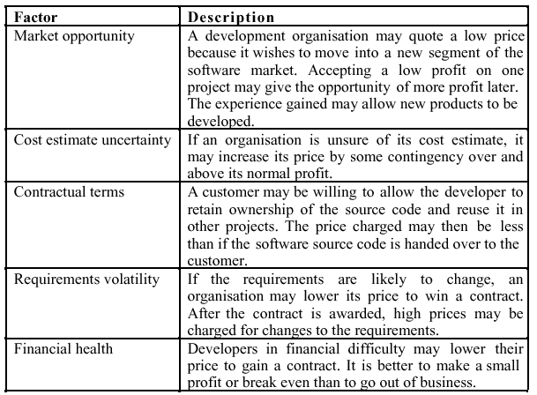
Software pricing factors

Slide 68
Size
Of source code
  LOC (Lines of Code)
Of documents
  Number of pages
  Number of words, characters, figures, tables
Of test
  N test cases

Slide 69
Size
Of entire project
  Function points (see later)
  LOC
    In this case LOCs virtually include all documents (non code) produced in the application
    Ex. project produces 10 documents (1000 pages) and 1000 LOCs. By convention project size is 1000 LOCs

Slide 70
LOC
What to count
    w/wout comments
    w/wout declarations
    w/wout blank lines
What to include or exclude
  Libraries, calls to services etc
  Reused components
Comparison for different languages not meaningful
  C vs Java? Java vs C++? C vs ASM?

Slide 71
Loc – what to include exclude
Depends on the goal of counting
  For cost estimation: count only what should be developed
  For memory occupation: count everything
  For price: consider whole functionality offered

Slide 72
Productivity
Output/effort
What is output in software?
  Size/effort = LOC / effort
    Inherits problems of LOC
  Functionality/effort = FP/effort
  Object Points / effort

Slide 73
LOC/effort
The lower level the language, the more
productive the programmer
  The same functionality takes more code to implement in a lower-level language than in a high-level language
The more verbose the programmer, the higher the productivity
  Measures of productivity based on lines of code suggest that programmers who write verbose code are more productive than programmers who write compact code

Slide 74
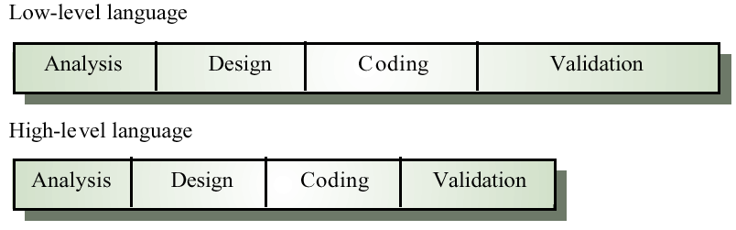
High and low level languages

Slide 75
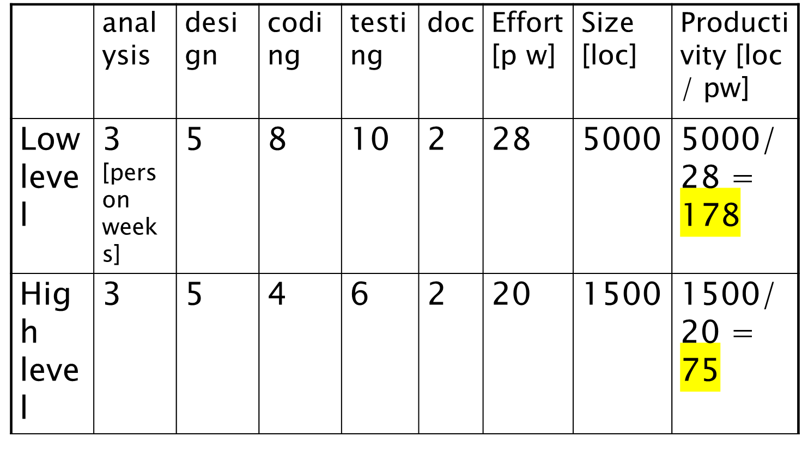
Productivity paradox

Slide 76
Productivity figures
Real-time embedded systems, 40-160 LOC/P-month
Systems programs , 150-400 LOC/P-month
Commercial applications, 200-800
LOC/P-month
Source: Sommerville

Slide 77
Productivity figures
Manufacturing
Retail
Public administration
Banking
Insurance
Source: Maxwell, 1999
0.34 FP/person hour
0.25
0.23
0.12
0.12

Slide 78
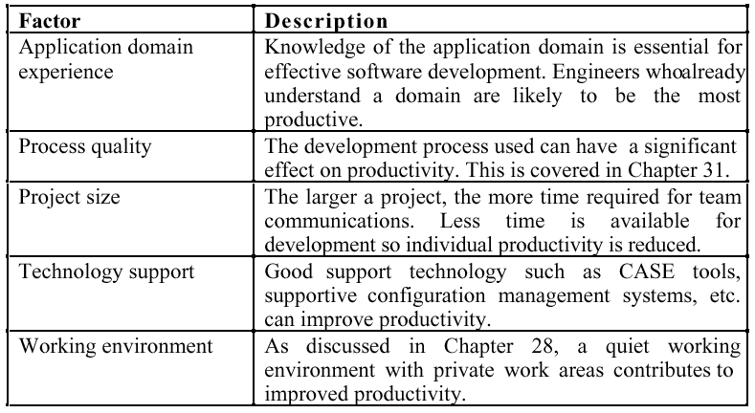
Factors affecting productivity

Slide 79
Quality and productivity
  All metrics based on size/effort are
  flawed because they do not take quality into account
  Productivity may generally be increased at the cost of quality
  It is not clear how productivity/quality metrics are related
  If change is constant then an approach based on counting lines of code is not meaningful

Slide 80
Failure vs. Fault
Failure
  malfunction perceived by the user
Fault
  defect in the system, may cause failure or not
causes
Fault
Failure
1, many
0, many
0, many
Software system

Slide 81
Failure
data to collect
    calendar time, project time, execution time
    effect (bad data, loss of data, ...)
    location (product type, id)
    gravity (human injury, economic loss, ..)
    user profile
    related fault(s)
measures
    classification, count per class
    average time intervals
Notes:
The discovery of a failure is an event, with no duration. The recording of the failure is an activity, which could be recorded apart. The detection of the related faults is not taken into account here.
Time between failures are input to reliability growth models. Classification of failures is an essential measure to characterise the product and to calibrate resources to allocate in fault detection.

Slide 82
Fault
data to collect
  effect (related failure, if any)
  location (product type, id)
  type (e.g. missing req, uninitialized var, logic error, .. )
  cause (communication, misunderstanding, clerical, .. )
  detecting method (test, inspection, ..)
  effort (finding and report handling)
Notes:
The discovery of a fault is an event, with no duration. The recording of the failure is an activity, which could be recorded apart. The detection of faults is an activity, which should be recorded apart.
The classification of faults is essential to plan improvements in the process (training on staff, use of suitable techniques, methods, tools) and in the product (identification of fault prone modules, more v&v or redesign of them). In particular it is important to monitor the effectiveness of the v&v techniques used (ex. inspection vs. test) to improve their use. This can be done by comparing the effort put in each v&v activity (test, inspection, walkthrough, cross reading, ..), the number of faults and (indirectly) of failures discovered by each one.
Usually few faults generate most of failures: it is essential therefore NOT to mix the recording of failures and faults.

Slide 83
Change
data to collect
  location
  cause (related fault if corrective, adaptive, perfective)
  effort
measures
  cost of failure

Slide 84
Fault, Failure, Change
measures
  n open failures
  duration/effort to close a failure
  n failures discovered per v&v activity
  fault/failure density
    faults/failures per module
    faults/failures per fp
    faults/failures per loc
  changes per document
Notes:
Faults/failures per loc inherits the defects of locs: depend on programming language (given the same number of faults the density increases with a higher level language), considers only coding.

Slide 85
Examples
Faults per module
Faults per phase
Faults vs size (fault density)

Slide 86
Ex faults per module / per phase
  Analyzed 2 releases of large telecommunication software system (Ericsson), around 2 yrs, 200 person years per release
  140, 246 modules, up to 6000 LOC
  4 intervals, pre/post release
prerelease
postrelease
Functional test
System test
Site test
Operation
time
Notes:
[fenton ohlsson] N. Fenton, N. Ohlsson, Quantitative Analysis of Faults and Failures in a Complex Software System IEEE TRANSACTIONS ON SOFTWARE ENGINEERING, VOL. 26, NO. 8, AUGUST 2000 797

Slide 87
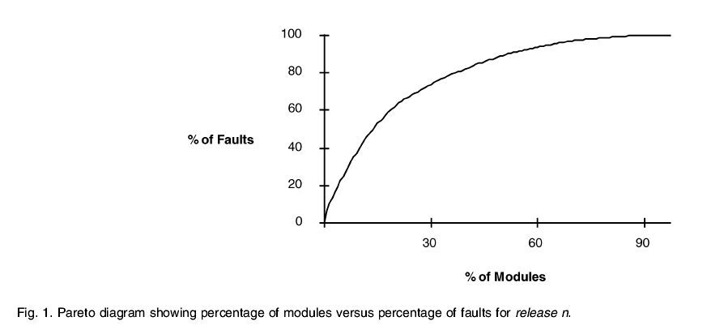
Prerelease faults
20% of modules cause 60% of faults
These modules account for 30% of size

Slide 88
Post release faults
10% of modules cause 80% of faults
Those modules account for 10% of total size

Slide 89
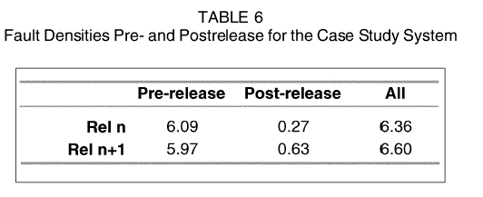
Fault densities
Benchmark
  Good: <1fault/1KLOC
  Bad: >10fault/1KLOC
    Faults found in operation, 1yr after release
  Prerelease:
    10-30 fault/1KLOC
  Factor 10 between pre and post release
Notes:
Fenton Ohlsson, TSE 2000

Slide 90
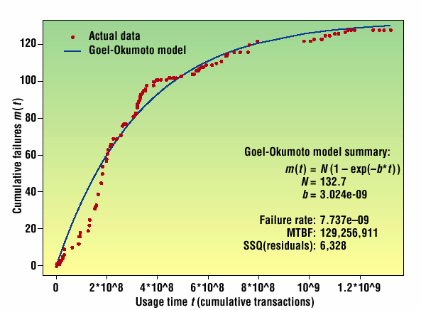
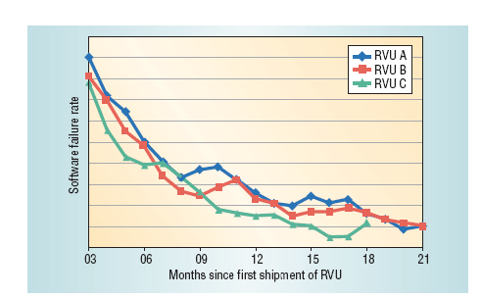
Fault rate per system

Slide 91
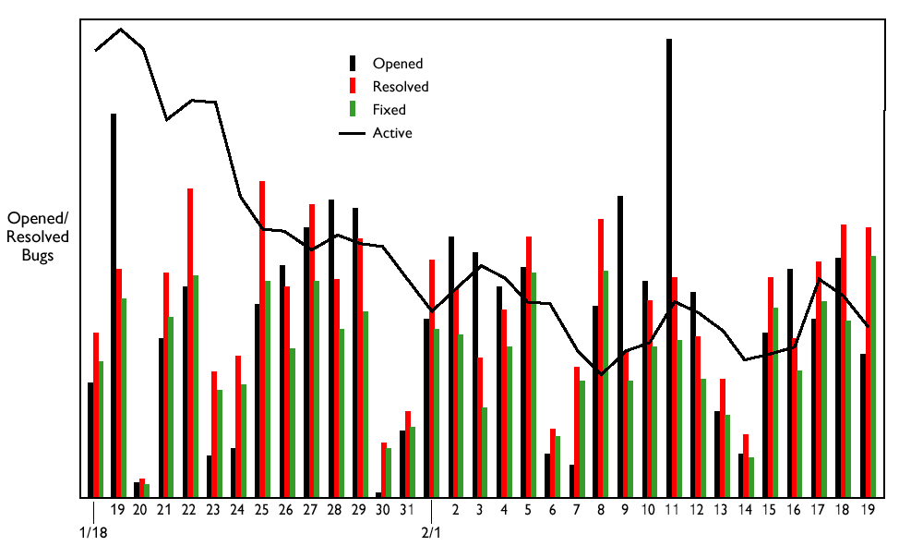
Fault rate / per status

Slide 92
Techniques

Slide 93
WBS
Work Breakdown Structure
Hierarchical decomposition of activities in subactivities
no temporal relationships

Slide 94
WBS example
Requirements planning
  Review existing systems
  Perform work analysis
  Model process
  Identify user requirements
  Identify performance requirements
  ...
Design
  ...
Implementation
  ...

Slide 95
PBS
Product Breakdown Structure
hierarchical decomposition of product
  Product
    Requirement document
    Design document
    Module 1
      Low level design
      Source code
    Module 2
      Low level design
      Source code
    Testdocument

Slide 96
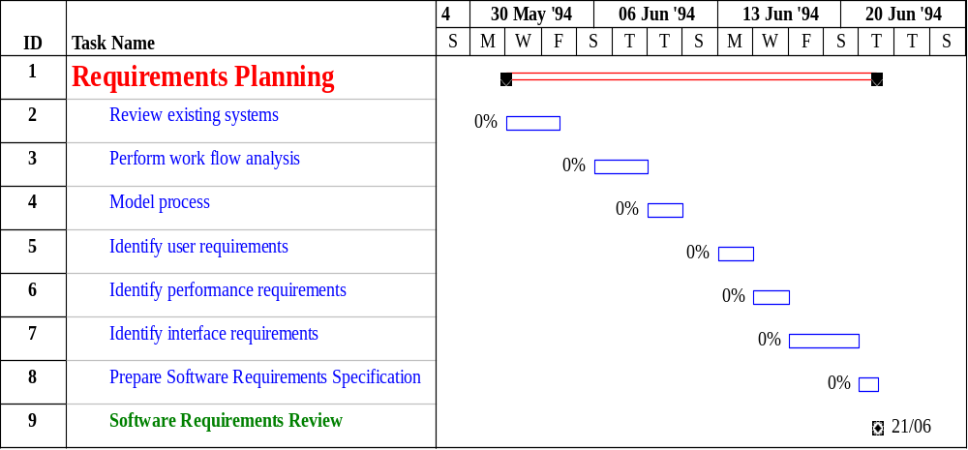
Gantt chart

Slide 97
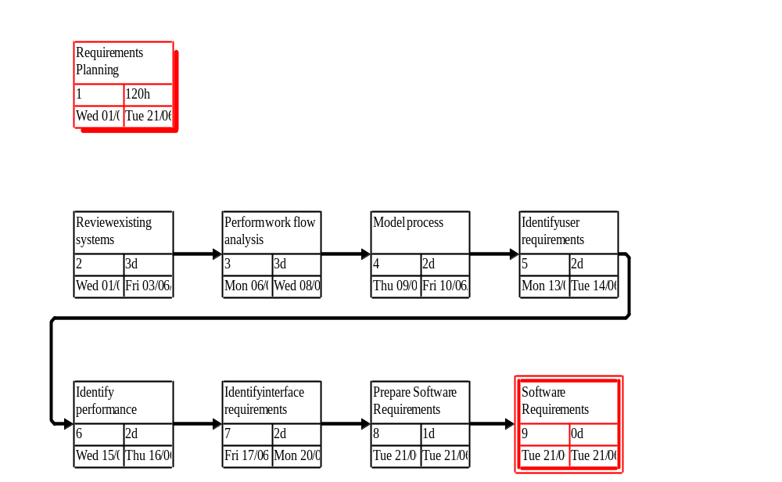
Pert

Slide 98
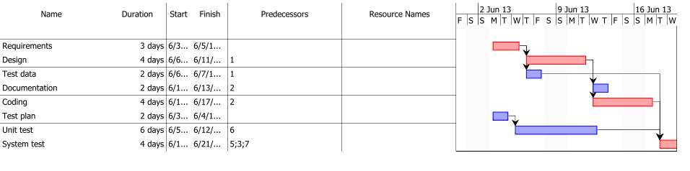
Gantt

Slide 99
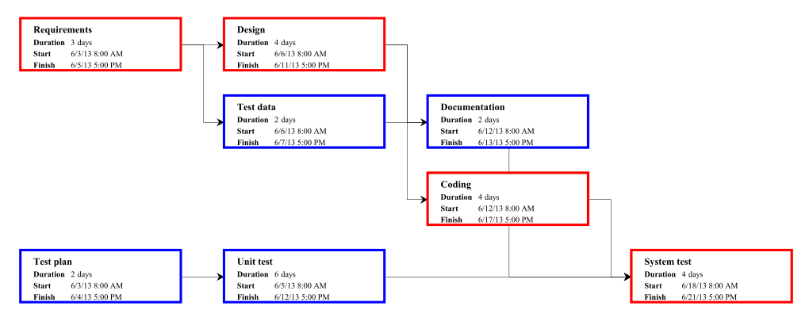
PERT

Slide 100
PERT
-directed acyclic graph:
node = activity, arrow = precedence relationship
Docum.
2
Design
4
Requir.
3
Coding
4
STOP
Test Data
2
START
System Test
4
Test
plan
2
Unit Test
6

Slide 101
Critical path analysis
What is shortest time to complete the project?
What are the critical activities to complete the project in shortest time?
Critical activities are the ones on the critical path(s)

Slide 102
Critical path
Path with longest duration
-
start end
(1) START label with (0,0)
(2) For each node N whose predecessors are labeled:
SN=max {Si} Si: end time for i-th predecessor
label N with (SN, SN+duration)
(3) Repeat (2) until all nodes labeled

Slide 103
Example
.
(7,9)
(3,7)
Docum.
(0,3)
Design
4
2
(15,15)
3
Requir.
(7,11)
(0,0)
(3,5)
Code
STOP
Test data
START
4
2
Unit Test
System Test
Test Plan
6
4
2
(11,15)
(0,2)
(2,8)

Slide 104
Analysis
- Late start latest time an activity can be started without changing end time of project
.
.
.
.
.
-
.Slack time Admissible delay to complete an activity

Slide 105
To Compute “Slack Time”
Start from graph (S,F) from critical path analysis, for each node compute new labels (S’,F’), max start and end times
1. For STOP (S’, F’)=(S,F).
2. For each node whose successors are labeled (S’, F’) compute min S’, that becomes F’ for the node S’=F’-duration Slack Time=S’- S (or also F’- F)
3. Repeat

Slide 106
Managerial Implications
1. Use slack time to delay start time, or lenghten, an activity
2. If duration of activity on critical path lenghtens by X, the whole project is delayed by X
3. If only one critical path exists, reducing duration of any activity on critical path shortens duration of project.

Slide 107
PM approaches

Slide 108
Two radically different approaches
  Depend on process model chosen: ‘waterfall’ vs ‘iterations’
Traditional, waterfall
  Requirements → project plan
Time framed, agile
  ‘Dynamic’ requirements, iterations

Slide 109
Waterfall | Iterations
Define requirements | 1 Define requirements (less deeply)
Estimate effort for all requirements | 2 Rank requirements
Define Gantt (one iteration) | 3 Pick top requirements feasible in one iteration (4 weeks)
Develop | Repeat 2,3 until finished

Slide 110
Ex waterfall
1 Define requirements
  F1, F2, F3, F4, F5, F6, F7
2 Estimate
  120 person days
Define Gantt
  3 people available
  Roughly 40 calendar days needed
Develop

Slide 111
Ex iterations
1 Define requirements
  F1, F2, F3, F4, F5, F6, F7
2 rank
  F7 (20pd) , F4 (25pd) , F2 (15), F5 (10), F1 (20), F3 (10), F6 (20)
3 Pick requirements for one iteration
  ex 3 people available x 4 weeks
  = 3x4x5 = 60 person days available

Slide 112
4 do iteration 1
  Deliver F7, F4, F2
Repeat ranking – requirements can change

Slide 113
Comparison
In theory in both cases F1 to F7 in 40 calendar days
In practice Iterations produce a different result

Slide 114
Comparison
Waterfall: suitable for stable environments, larger projects, dependencies on hardware, safety critical
  Ex automotive, aerospace
Iterative: suitable for dynamic environments, smaller projects

Slide 115
The following applies mostly to waterfall processes

Slide 116
The PM activities
planning (estimation, scheduling)
tracking replanning
post mortem
Development
deployment
official project start
release
Operation
Maintenance
time
Notes:
Not really in scale
PM starts before the process (official start with contract signed)
In planning: estimation and scheduling

Slide 117
Planning

Slide 118
Planning Process
Identify activities and/or deliverables
  PBS, WBS
  reference models (CMM, ISO12207)
estimate effort and cost
define schedule (Gantt)
analyze schedule (Pert)

Slide 119
Project plan
living document
  will be updated during tracking
outline
  list of deliverables, activities
  milestones
  Gantt
  Pert
  personnel organization
  roles and responsibilities

Slide 120
Estimation

Slide 121
Estimation of cost and effort
Based on analogy
  requires experience from the past to ‘foresee’ the future
    Experience can be qualitative (in mind of people) or quantitative (data collected from past projects)
  the closer a project to past projects, the better the estimation

Slide 122
Estimation accuracy
  The cost/effort/size of a software system can only be known accurately when it is finished
  Several factors influence the final size
    Use of COTS and components
    Programming language
    Distribution of system
  As the development process progresses then the estimate becomes more accurate

Slide 123
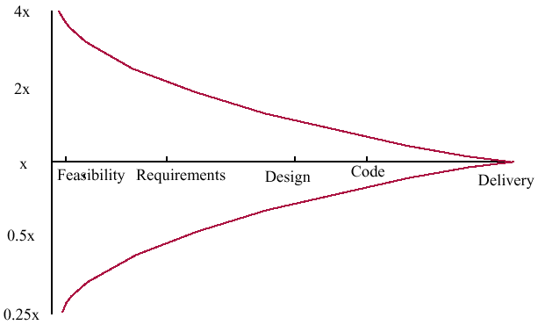
Estimate uncertainty

Slide 124
Estimation techniques
Not suggested, but used ..
  Parkinson’s law
  Pricing to win

Slide 125
Techniques - suggested
Based on judgment
  Decomposition
    By activity (WBS)
    By products (PBS)
  Expert judgment
  Delphi
Based on data from the company
  Analogy, case based
  Regression models
Based on data, from outside the company
  Cocomo, Cocomo2
  Function points
  Object points

Slide 126
Parkinson's Law
The project costs whatever resources are available
Advantages: No overspend
Disadvantages: System is usually unfinished

Slide 127
Pricing to win
The project costs whatever the customer has to spend on it
Advantages: You get the contract
Disadvantages: The probability that the customer gets the system he or she wants is small. Costs do not accurately reflect the work required

Slide 128
By decomposition
By activity
  Identify activities (WBS)
  Estimate effort per activity
  Aggregate (linear)
By product
  Identify products (PBS)
  Estimate effort per product
  Aggregate (linear)
Rationale: easier to estimate smaller parts

Slide 129
Ex: requirements
Activity | Estimated effort (person days)
Review existing systems | 5
Perform work analysis | 5
Model process | 1
Identify user requirements | 10
Identify performance requirements | 4
TOTAL | 25

Slide 130
Expert judgement
one (or more) experts (chosen in function of experience) propose an estimate

Slide 131
Delphi
evolution of expert judgement
structured meetings to achieve consensus in estimate
  each participant proposes estimate (anonymous)
  team leader publishes synthesis
    (a + 4m + b)/6 (beta distribution)
    a best - b worst - m mean
  iterate

Slide 132
By analogy, case based
A set of projects
Each project has a number of attributes (with respective values)
  Ex size, technology, staff experience, effort, duration, etc
Define attributes for new project
Find ‘near’ project(s)
  Distance function
Use (adapted) effort of near project
Notes:
See AQUA paper, EMSE 2005

Slide 133
Ex.
  See file MaxwellDataSetChap1.xls
New project
  We estimate
    size = 200fp, application type =transpro, telonuse = no
  Near projects (yellow rows) have effort
    7320, 1520, 963, 5578
  We estimate effort at
    Average of effort of yellow projects= 3845

Slide 134
Regression models
If the company has a data base of past projects
  min info required: size, effort
  See file MaxwellDataSetChap1.xls
apply regression (linear, or else)
Estimate productivity
Estimate size, compute effort

Slide 135
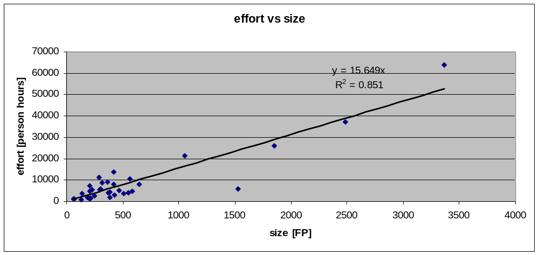
Linear regression

Slide 136
Ex.
Using Maxwell data set, linear regression effort vs. size on all projects gives
  Productivity = 1/15.649 fp/person hour
  0.063 fp per person hour
  R2 = 0.85 (good model)
Given new project
  We estimate size =200fp
  Estimated effort = 200*15.649 = 3773 ph

Slide 137
Function Points
fp = A*EI + B*EO + C*EQ + D*EIF + E*ILF
  EI = number of Input Item
  EO = output item
  EQ = Inquiry
  EIF= External Interface File
  ILF = Internal Logical File

Slide 138
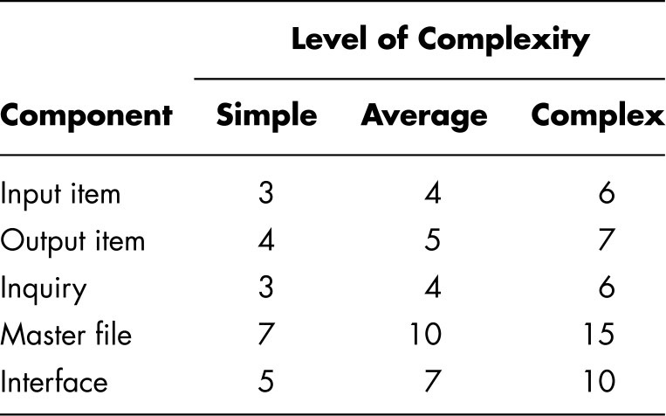
Coefficients A,B,C,D,E

Slide 139
Function Points
For any product, size in “function points” is given by
    FP = 4 × EI + 5 × EO + 4 × EQ + 10 × ILF + 7 × EIF
A 3-step process.

Slide 140
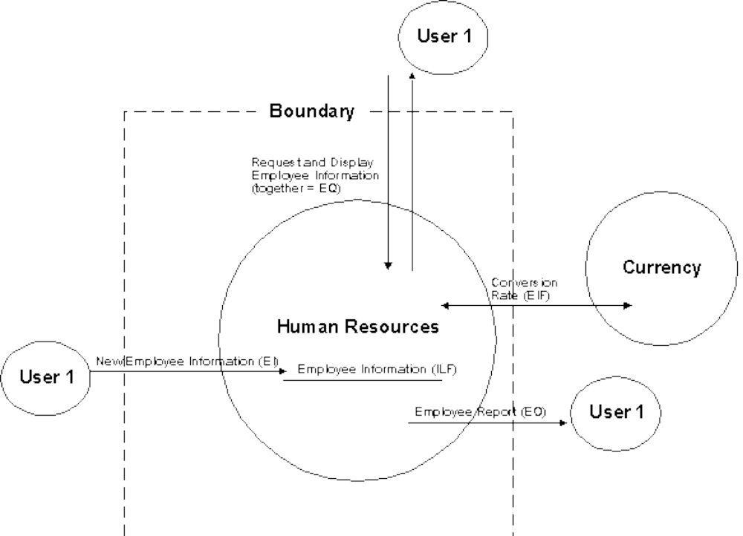

Slide 141
Function Points (2)
1. Classify each component of product (EI, EO, EQ, ILF, EIF) as simple, average, or complex.
  Assign appropriate number of function points
  Sum gives UFP (unadjusted function points)

Slide 142
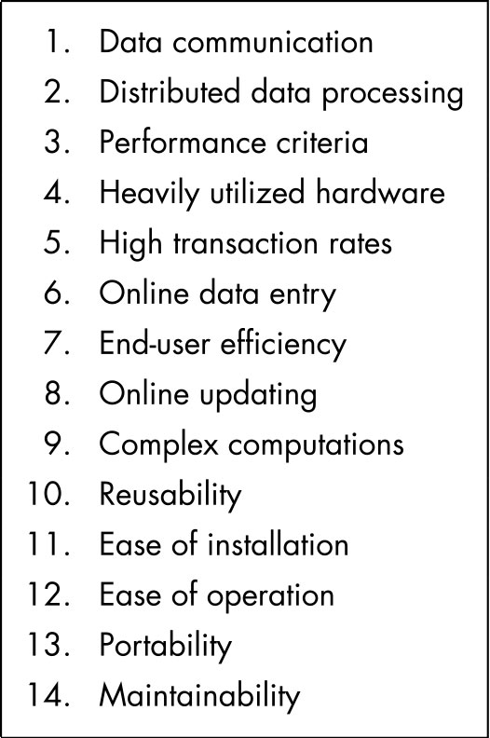
Function Points (3)
2. Compute technical complexity factor (TCF)
  Assign value from 0 (“not present”) to 5 (“strong influence throughout”) to each of 14 factors such as transaction rates, portability
  Add 14 numbers ⇒ total degree of influence (DI)
    TCF = 0.65 + 0.01 × DI
  Technical complexity factor (TCF) lies between 0.65 and 1.35

Slide 143
Function Points (4)
3. Number of function points (FP) given by
    FP = UFP × TCF

Slide 144
Function Points
suitable for MIS
  use of adjustment factors delicate
  FP expert should do estimate
    long, expensive
conversion tables FP - LOC
      Cobol 110
      C 128-162
      C++ 53-66
      Java 53-62
conversion tables FP - effort
    www.ifpug.org

Slide 145
FP
Advantage
  Independent of technology
  Independent of programmer
  Well established and standardized
Downside
  Counting long and expensive
  Transaction system oriented (no real time, no embedded systems)

Slide 146
FP vs. LOCS
 | FP | LOCs
Depend on prog language | N | Y
Depend on programmer | N | Y
easy to compute | N, must be done by trained person | Y, tool based (after end of project)
Applicable to all systems | N, transaction oriented | Y

Slide 147
FP as unit of exchange
Company A bids for FP
  Buy 10000 FP, how much? (bid)
  providers answer, x Euro per FP
A selects provider
  lowest cost and other factors
End of year, redo counting
  10123 FP actually delivered
  A pays

Slide 148
Reminder
Measures of size
  FP, LOC
Both can be computed
  Before a project start (estimated size)
  After a project ends (actual size)
Both can be used to
  Characterize productivity
    FP/effort, LOC/effort
  Characterize application portfolio
    FP or LOC owned and operated by a company

Slide 149
Function points
IFPUG
  FP Counting Guide
  Exams/ certified counters
GUFPI
(CNIPA)

Slide 150
Sw project Data sets
Company specific
  When exists
  Maxwell, Applied statistics for software managers, Prentice Hall
Public
  Knowledge plan (Caper Jones)
  Software productivity research
  ISBSG, Int. software benchmarking standards group, www.isbsg.org

Slide 151
Scheduling

Slide 152
Project duration
As well as effort estimation, calendar time must be estimated, and staff allocated
Scheduling can be done on Gantt/Pert
COCOMO2 gives also an estimate of calendar time
  Independent of staffing

Slide 153
Calendar time can be estimated using a COCOMO 2 formula
  TDEV = 3 × (PM)^{(0.33+0.2*(B-1.01))}
  PM is the effort computation and B is the exponent computed as discussed above (B is 1 for the early prototyping model). This computation predicts the nominal schedule for the project

Slide 154
Staffing requirements
  Staff required can’t be computed by dividing the development time by the required schedule
  The number of people working on a project varies depending on the phase of the project
  The more people who work on the project, the more total effort is usually required
  A very rapid build-up of people often correlates with schedule slippage

Slide 155
Staffing profile
Number of people working on the project vs. time
Typically has a bell shape
  duration of project is constrained by staffing profile + total effort estimated
#people
C
UT
D
IT
ST
R
time

Slide 156
The PM activities
planning (estimation, scheduling)
tracking replanning
post mortem
Development
deployment
official project start
release
Operation
Maintenance
time
Notes:
Not really in scale
PM starts before the process (official start with contract signed)
In planning: estimation and scheduling

Slide 157
Tracking

Slide 158
Tracking process
project has started - how to know status of project?
collect project data, define actual status
compare estimated – actual
  Estimated Gantt is the roadmap for project
if deviations, do corrective actions
  change personnel, change activities, change deliverables, ...
  re-plan, update Gantt and PERT

Slide 159
Time sheet
Basic tool to collect actual effort spent by employees
  Per day, Per project, per activity in project
Allows to collect
  Actual effort spent per project
To track project status
To compute cost of project

Slide 160
Time sheet -ex1
Employee name: John Smith - week 13-17 apr 2019
day | Project X | Project Y | Sick leave | Vacation leave | Training
13 apr | 4 | 4
14 apr |  |  |  | 8
15 apr |  | 8
16 apr |  | 4 |  |  | 4
17 apr
TOT | 4 | 16 |  | 8 | 4

Slide 161
Time sheet -ex2
Employee name: John Smith - week 13-17 apr 2019
day | Project X - req | Project X - design | Project X - coding | Project X - testing | Sick leave | Vacation leave | Training
13 apr | 2 | 2 | 4
14 apr |  |  |  |  |  | 8
15 apr |  |  | 4 | 4
16 apr |  | 2 |  |  |  |  | 4
17 apr
TOT | 2 | 4 | 8 | 4 |  | 8 | 4

Slide 162
EZGas timesheet
Week | requirement engineering | design | coding | unit testing | integration testing | acceptance testing | management | git maven
apr 13 - 19
apr 20 - 27
apr 28 - 3
may 4 - 10
may 11 - 17

Slide 163
Project status
Option1
  Effort spent
Option2
  Effort spent + activities closed
Option3
  Earned value

Slide 164
Effort spent
Collect effort spent, compare with estimated
  Ex, spent 10, estimated 100, we are done 10%
Big flaw, confounds input measure (effort spent) with output measure (completion)

Slide 165
The first 90% of a project takes 90% of the time, the last 10% takes the other 90% of the time
[Murphy’s law]

Slide 166
Activities closed
How to define when activity is closed?
  All effort planned for activity is spent
    Same problem, confounds input with output
  Define quality gate, level to achieve
    Ex, requirements: inspection meeting, majority of participants judges document is goodenough
    Ex, unit testing: coverage 95% of nodes, and all tests pass

Slide 167
Earned value
A technique to measure progress of a project
Step 1: identify activities, assign a value to them (Planned Value, PV), schedule them
80
a1, PV20
a2, PV10
40
a3, PV20
a4, PV30
10
w1
w2
w3
w4
w5
w6
w7
w8
w9
w10
Notes:
Planned value can be in %, in planned effort, in planned cost
In example is in units (could be effort units)
One step

Slide 168
Earned value
Step 2: define a rule to pass from PV to EV (rule1 0/100 or rule2 0/50/100)
  With rule1, the project earns the PV of an activity when the activity is 100% finished
80
a1, PV20
PV
a2, PV10
40
a3, PV20
a4, PV30
10
w1
w2
w3
w4
w5
w6
w7
w8
w9
w10
Notes:
Pv of project is sum of pv of activities, obtained with rule 1 (only when 100% complete)

Slide 169
Earned value
Step 3: start the project, measure EV and compare with PV
SV
80
PV
a1, PV20
a2, PV10
40
a3, PV20
a4, PV30
EV
10
w1
w2
w3
w4
w5
w6
w7
w8
w9
w10
Notes:
A1 finishes late, EV is obtained mid week 3 (EV = 20)
A2 is on time, but delay from a1 (EV = 20+10)
This project is late, (see schedule variance) SV

Slide 170
Earned value
Step 4: compute also AC, actual cost
CV
80
PV
a1, PV20
a2, PV10
40
a3, PV20
a4, PV30
AC
10
w1
w2
w3
w4
w5
w6
w7
w8
w9
w10
Notes:
AC is not exactly PV, so worth computing it – may be late but spent less (first case)
CV cost variance is delta in cost

Slide 171
The PM activities
planning (estimation, scheduling)
tracking replanning
post mortem
Development
deployment
official project start
release
Operation
Maintenance
time
Notes:
Not really in scale
PM starts before the process (official start with contract signed)
In planning: estimation and scheduling

Slide 172
Post Mortem

Slide 173
Post mortem
A form of organizational learning
Collect key information from the project
  Effort, faults – estimated and actual
  Achievements
  Problems and causes
To make it available to other projects

Slide 174
PMA – learn from experience
PMA (when used appropriately) PMA ensures that team members recognise and remember what they learned during a project.
PMA identifies improvement opportunities and provides means to initiate sustained change.
PMA provides qualitative feedback
Two types
  General PMA
  Focused PMA – understanding and improving a project`s specific activity

Slide 175
PMA process
Preparation
  Study the project history to understand what has happened
  Review all available documents
  Determine goal for PMA
  Example of goal: Identify major project achievements and further improvement opportunities.

Slide 176
PMA process cont.
Data collection
  Gather relevant project experience
  Focus on positive and negative aspects
  Semistructured interviews – pre-prepared list of questions
  Facilitated group discussion
  KJ sessions
    Write down up to four positive and negative project experience on post-it notes.
    Put the notes on a whiteboard
    Re-arrange notes into groups and discuss them

Slide 177
PMA process cont.
Analysis
  Feedback session
    Have we (analyser) understood what you (project member) told us, and do we have all the relevant facts?
  Ishikawa diagram in a collaborative process to find the causes for positive and negative experiences
    Draw an arrow on a whiteboard – which is label with experience
    Add arrows with causes (the diagram will look like a fishbone)

Slide 178
PMA – results and experience
Document the PMA results in a project experience report
  Project description
  Projects main problems, with description and Ishikawa diagrams
  Project main success, with descriptions and Ishikawa diagrams
  PMA meeting as an appendix (to let the reader see how the team discussed problems and successes)

Slide 179
Collecting and using measures

Slide 180
The measurement process
A process should be defined and implemented to collect data, derive and analyze measures
Data collected during this process should be maintained as an organisational resource
Once a measurement database has been established, comparisons across projects become possible

Slide 181
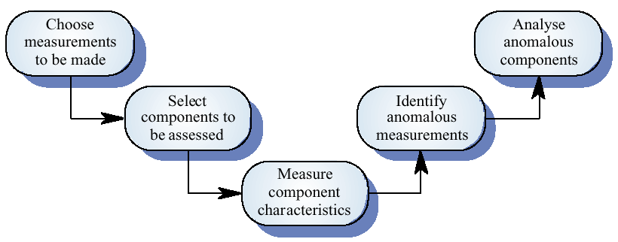
Product measurement process

Slide 182
GQM
Focus on few, important measures (top down)
Never “collect everything, analyze later” (bottom up)
  Too much data
  Not meaningful

Slide 183
Goal - (similar to KPI)
G1Satisfying customer
  What is satisfaction?
    Interviews
  What is quality of product?
    Defects after delivery
G2 produce low cost product
  What is cost
    Cost of development

Slide 184
Typical indicators
Effort (Cost)
Size
Defects after delivery
Defects during development

Slide 185
GQM example
Overall research question
  Are UML Object diagrams useful?

Slide 186
Goal
Object of study
  UML Static structure diagrams
Purpose
  Evaluate
Focus
  Usefulness
Point of view
  Maintainer comprehending software
Context
  Master degree class

Slide 187
Data collection
A metrics programme should be based on a set of product and process data
Data should be collected immediately (not in retrospect) and, if possible, automatically
Data should be controlled and validated as soon as possible

Slide 188
Data accuracy
Don’t collect unnecessary data
    The questions to be answered should be decided in advance and the required data identified
Tell people why the data is being collected
    It should not be part of personnel evaluation
Don’t rely on memory
    Collect data when it is generated not after a project has finished

Slide 189
Data presentation
Reports
Web reports
Dashboard

Slide 190
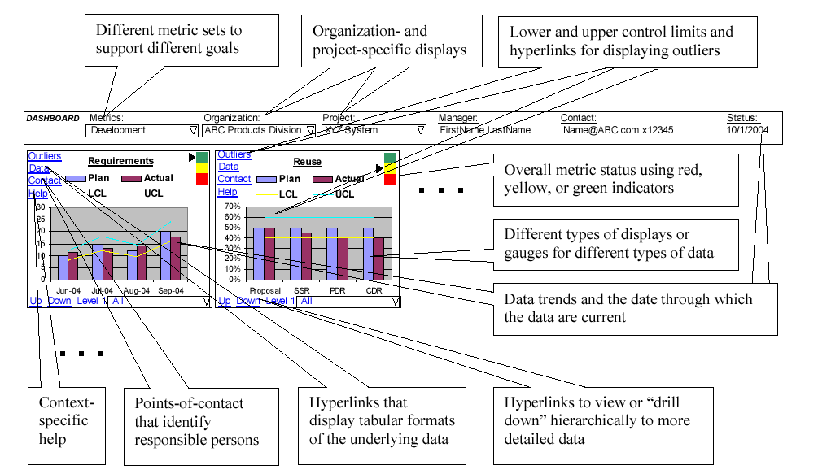
Dashboard

Slide 191
Personnel

Slide 192
Project personnel
Key activities requiring personnel:
  requirements analysis
  system design
  software design
  implementation
  testing
  training
  maintenance
  quality assurance

Slide 193
Choosing personnel
ability to perform work
interest in work
experience with
  similar applications
  similar tools or languages
  similar techniques
  similar development environments
training
ability to communicate with others
ability to share responsibility
management skills

Slide 194
Work styles
Extroverts: tell their thoughts
Introverts: ask for suggestions
Intuitives: base decisions on feelings
Rationals: base decisions on facts, options

Slide 195
Organizational structure
Depends on
  backgrounds and work styles of team members
  number of people on team
    n people, max interactions = n²/2
  management styles of customers and developers
Examples:
  Chief programmer team
  Egoless approach

Slide 196
Organizational structures
Highly structured
high certainty
repetition
large project
Loosely structured
uncertainty
new technology
small projects

Slide 197
Risk management

Slide 198
Nothing is easy as it looks
Everything takes longer than you expect
And if anything can go wrong, it will, at the worst possible moment
[Murphy’s law]

Slide 199
Risk management
Project Management for adults
If you don’t actively attack the risks,
they will actively attack you
Tom Gilb
Notes:
come avvocato mi scervellavo per immaginare tutti i rischi possibili
come manager trasformo rischi in opportunita
de sole/gucci
coso per pavimenti bagnati - figura

Slide 200
Risk Management
Software system (functions, quality)
Risks
Calendar time
Costs

Slide 201
Strategies
Reactive
  “Indiana Jones school of risk management”
  Risk management = Crisis management
  (“fire-fighting mode”)
Proactive

Slide 202
Risk management (proactive)
Identify risks
analyze them
quantify effects
define strategies and plans to handle them

Slide 203
Risk
  Future event that can have (bad) impact on project

Slide 204
Risk categories
Project
Technical
Business
Known
Predictable
Unknown

Slide 205
Project Risks
Regarding (ill defined) project plan
  budget, personnel, timings, resources, customers
Regarding management
  No management support
  Missing budget or people

Slide 206
Technical risks
Regard feasibility of product
  Design, interfaces, verification, ..

Slide 207
Business risks
Regarding market or company
  No market for the product (market risk)
  Product not in scope with company plans (strategic risk)
  Sales force does not know how to sell the product (sales risk)

Slide 208
Known risks
Identified analyzing project characteristics
Ex:
  Unrealistic deadlines
  No requirements
  No focus
  Poor development environment

Slide 209
Predictable risks
Identified analyzing previous projects
Ex.
  Personnel turnover
  Poor communication with customer

Slide 210
Unknown
Hard or impossible to identify..

Slide 211
Boehm’s top ten risk items
  Personnel shortfalls
  Unrealistic schedules and budgets
  Developing the wrong functions
  Developing the wrong user interfaces
  Gold-plating
  Continuing stream of requirements changes
  Shortfalls in externally-performed tasks
  Shortfalls in externally-furnished components
  Real-time performance shortfalls
  Straining computer science capabilities

Slide 212
Other common risks
  instability of COTS (Commercial Off-The-Shelf) components/products
  interface with legacy
  stability of development platform (hw + sw)
  limitations of platform
  multi-site development
  use of new methodologies / technologies
  standards, laws
  development team involved in other activities
  communication/language problems

Slide 213
Risk management terms
Risk impact: the loss associated with the event
Risk probability: the likelihood that the event will occur
Risk control: the degree to which we can change the outcome
Risk exposure = (risk probability) x (risk impact)

Slide 214
RM Process
1- Risk assessment
  identification
  analysis
  ranking
2- Risk control
  planning
  monitoring

Slide 215
Identification
identify risks
  checklist, taxonomies, questionnaires
    PMI (Project Management Institute, PMBOK)
    SEI (SEI-93-TR-06)
      ex: technical, management, business risks
  brainstorming
  experience

Slide 216
Analysis
probability
  very high, high, medium, low, very low
impact
  catastrophic, critical, marginal, negligible
exposure
  probability * impact

Slide 217
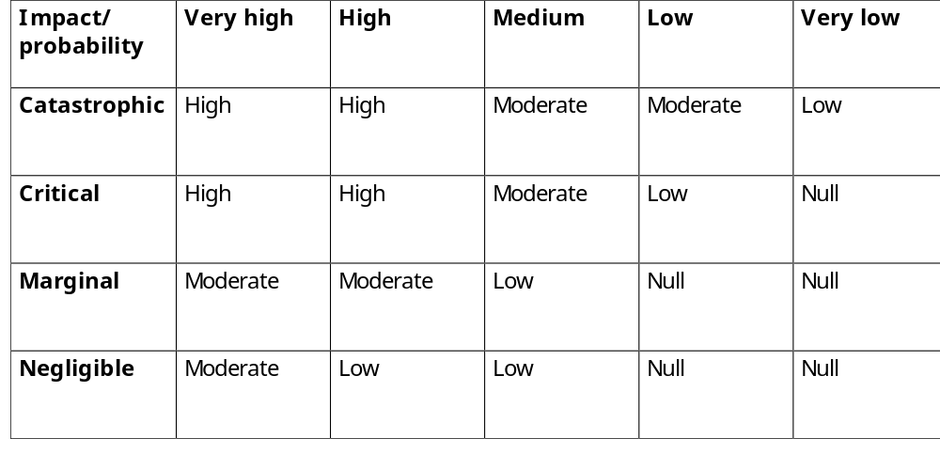
Exposure

Slide 218
Ranking
By exposure
by qualitative assessments
  only higher exposure risks are handled

Slide 219
RM Process
1- Risk assessment
  identification
  analysis
  ranking
2- Risk control
  planning
  monitoring

Slide 220
Planning
For selected risks (high in exposure)
  define corrective actions
  evaluate cost, decide if acceptable
  insert actions in project plan

Slide 221
Three strategies for risk reduction
  avoiding the risk: change requirements for performance or functionality
  transferring the risk: transfer to other system, or buy insurance
  assuming the risk: accept and control it
risk leverage = difference in risk exposure divided by cost of reducing the risk

Slide 222
Ex.
ABS for car, software controlled. More flexible, but risk of failure from software
  Avoiding. No software controlled
  Transfer. Insurance.
  Assuming. Develop software with best techniques, apply redundancy.

Slide 223
Ex.
Risk leverage
  ABS, software developed normally
    cost 100KEuro,
    risk exposure = 10⁻³ * 1M Euro
  ABS, software developed best techniques
    cost 1M Euro,
    risk exposure = 10⁻⁶ * 1M Euro
  Risk leverage
    (10⁻³ * 1M Euro - 10⁻⁶ * 1M Euro) /
    (1M – 100k)Euro

Slide 224
Company profiles and risk handling styles
project owner - takes charge of risk
fixed price contract
work provider - no interest in risk

Slide 225
Monitoring
follow project plan, including corrective actions
monitor status of risks
identify new risks, assess them, update ranking

Slide 226
Monitoring (2)
Is part of PM that has to consider also
  risk log (document)
  risk reviews (activities)
    also with external assessors
    can be coupled with project reviews

Slide 227
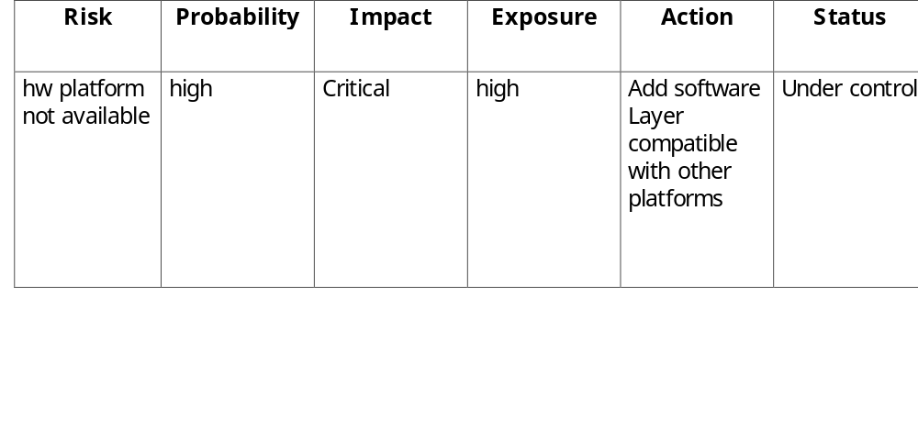
Risk log

Slide 228
Actions for risks
Personnel shortfalls
  hire the best, the most suitable, training, team building, technical reviews
unrealistic schedules and budget
  more detailed plans, iterative process, reuse, new plans
instability of components (COTS)
  qualification, detailed analysis of product and vendor, software layer.

Slide 229
inadequate requirements
  prototyping, JAD, iterative process, include user representative in process
    Joint Application Development
inadequate user interface
  study user needs, usability analysis, prototyping
requirement changes
  suitable design, iterative process, rigid change control

Slide 230
Interface with legacy
  reengineering, encapsulation, incremental change
subcontractors
  contracts and payments, team building, assessments before and during
new technologies
  prototyping, cost benefit analysis

Slide 231
References
www.pmi.org project management institute
www.sei.cmu.edu
www.ifpug.org
http://www.itmpi-journal.com
www.fhg.iese.de – Fraunhofer IESE
Rapid Development - Taming Wild Software Schedules, Steve McConnell, Microsoft Press, 1996
Software Engineering Risk Management, Dale Walter Karolak, IEEE Computer Society Press, 1996
Assessment and Control of Software Risks , Caper Jones, Yourdon Press, 1994
Software Risk Management - Principles and Practices, Barry W.Boehm, IEEE Software, Vol 8, No. 1, Jan 1991, PP32-41
Taxonomy-Based Risk Identification, M.J.Carr et al., CMU/SEI-93-TR-06, SEI, 1993
Www.riskwatch.com - Risk management tools

